Slide 1
Intelligent Sentiment Classification on tweets
Under the supervison of : Mr. J. Arul Valan
By:
Lipokmerenla(2013105075)
Indrasen Singh(2013105071) Durga Shankar Mishra(2013105070)
COMPUTER SCIENCE AND ENGINEERING
National institute of technology nagaland

Slide 2
Content
Sentiment Analysis Introduction
Some Analyzed Points
Problem Statement
Objective
Proposed Work
Preprocessing
Algorithm
Decision Tree Classifier
Naïve Bayes Classifier
Implementation
Result
Future Work
Conclusion

Slide 3

Every second, there are around 8,222 tweets on Twitter.

Slide 4
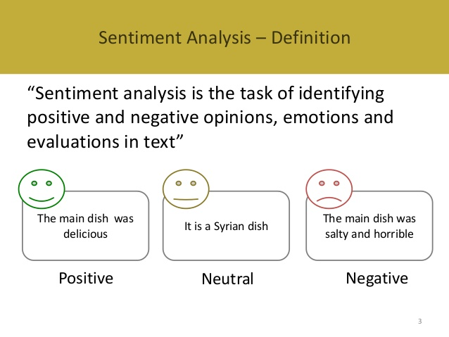

Slide 5
Problem Statement
The problem in sentiment analysis is classifying the polarity of a given tweet at the feature/aspect level.
Whether the expressed opinion in a document , a sentence or an entity feature/aspect is positive, negative or neutral.

Slide 6
Introduction
The booming Micro blog service, Twitter , attract more people to post their feelings and opinions on various topics.
The posting of sentiment contents can not only give an emotional snapshot of the online world but also have potential commercial and sociological values.
However, facing the massive sentiment tweets, it is hard for people to get overall impression without automatic sentiment classification and analysis.

Slide 7
Objective
To implement an algorithm for automatic classification of text into positive ,negative or neutral.
Sentimental Analysis to determine the attitude of the mass is positive , negative or neutral towards the subject of interest.
Graphical representation of the sentiment in the form of Bar-Graph.

Slide 8
Proposed Work

Slide 9
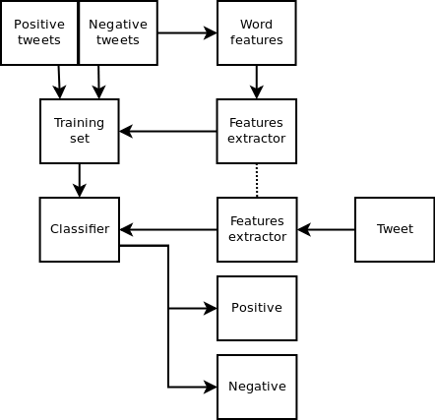

Slide 10
Preprocessing

Slide 11
Tokenization
Given input as character sequence, tokenization is a task of chopping it up into pieces called tokens and at the same time removing certain characters such as punctuation marks. A token is an instance of sequence of characters that are grouped together as a useful semantic unit for processing.

Slide 12
Lowercase Conversion
Tweet may be normalized by converting it to lowercase which makes it’s comparison with an English dictionary easier

Slide 13
Stop word removal
Some of the more frequently used stop words for English include "a", "of", "the", "I", "it", "you", and ”and” these are generally regarded as 'functional words' which do not carry meaning.

Slide 14
Convert the web addresses to “url”.
Convert @username to “at_user”.
Remove white spaces .

Slide 15
ALGORITHM

Slide 16
1. DECISION TREE CLASSIFIER

Slide 17
Decision Tree Introduction
A decision tree is a tree with the following properties:
An inner node represents an attribute.
An edge represents a test on the attribute of the father node.
A leaf represents one of the classes.
Construction of a decision tree
Based on the training data
Top Down strategy

Slide 18
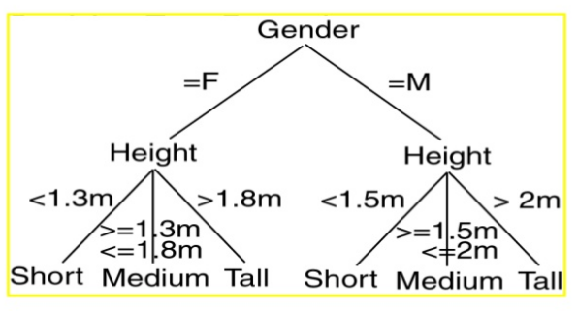
Decision Tree Example

Slide 19


Attribute Selection Measures
Information Gain :
The expected information needed to classify a tuple in D is given by
How much more information would we still need (after the partitioning) to arrive at an exact classification? This amount is measured by

Slide 20
The Decision tree algorithm
Until stopped:
Select a leaf node
Select one of the unused attributes
Partition the node population and calculate information gain
Find the split with maximum information gain for a this attribute
Repeat this for all attributes:
Find the best splitting attribute along with best split rule
Spilt the node using the attribute
Go to each child node and repeat step 2 to 4
Stopping criteria:
Each leaf-node contains examples of one type
Algorithm ran out of attributes
No further significant information gain

Slide 21
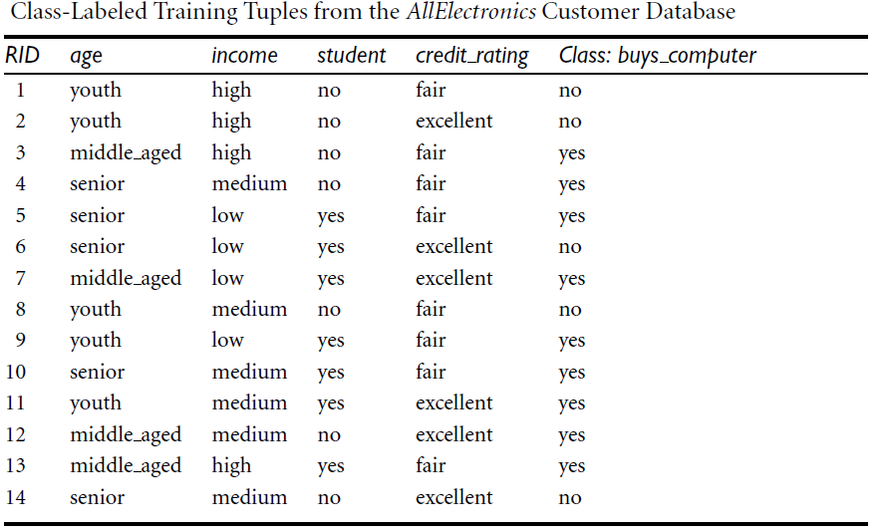

Slide 22


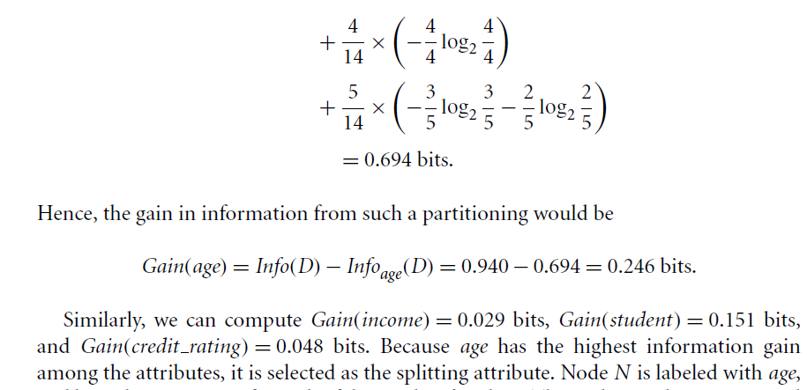

Slide 23
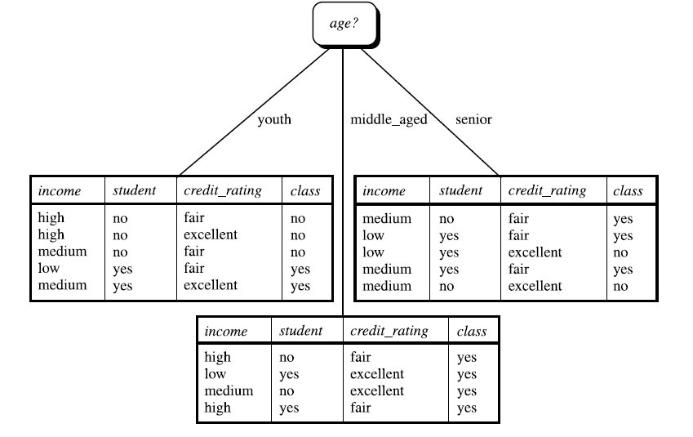

Slide 24
2.NAIVE BAYES CLASSIFIER

Slide 25
Introduction to Naïve Bayes :
Naive Bayes classifiers are a family of simple probabilistic classifiers based on applying Bayes' theorem with strong independence assumptions between the features.
Naive Bayes classifiers are highly scalable.
For some types of probability models, naive Bayes classifiers can be trained very efficiently.
Despite their naive design and oversimplified assumptions, it has worked quite well in many complex real-world situations.
It requires only a small number of training data to estimate the parameters necessary for classification

Slide 26
How it works
Bayes theorem provides a way of calculating the posterior probability, P(c|x) from P(c), P(x), and P(x|c).
Naive Bayes classifier assumes that the effect of the value of a predictor (x) on a given class (c) is independent of the values of other predictors.

Slide 27
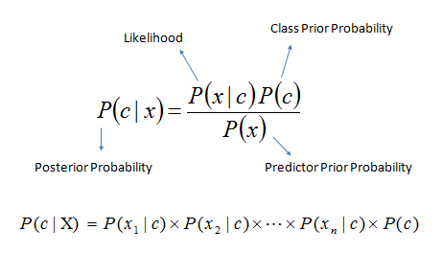
P(c|x) is the posterior probability of class (target) given predictor (attribute).
P(c) is the prior probability of class.
P(x|c) is the likelihood which is the probability of predictor given class.
P(x) is the prior probability of predictor.

Slide 28
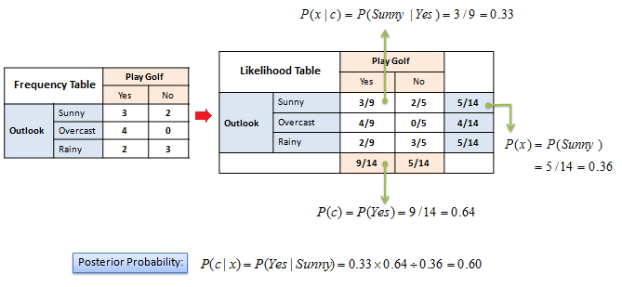
Example:
Figure : Example of Naïve Bayes

Slide 29
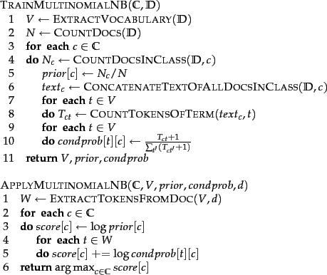
Text Classification by Naïve Bayes

Slide 30
Implementation
We have implemented using our own classifier , which is an implementation of Naïve Bayes Classifier.
We have used four other Classifiers:
Naïve Bayes
Bernoulli Naïve Bayes
Multinomial Naïve Bayes
Decision Tree Classifier
Then we compare of the accuracies of each Classifier.

Slide 31
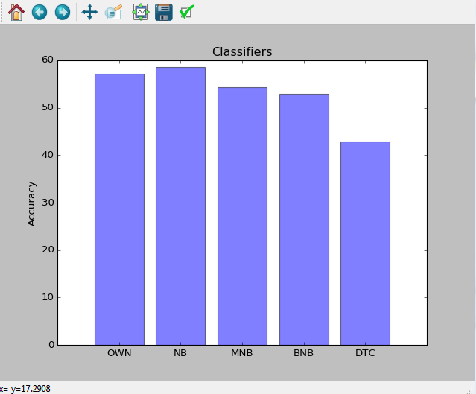
Result:

Slide 32
Future Work
We have used three different types of classifiers, in future we are going to use to more classifiers and take the majority voting of these classifiers to predict more accurate results.
We need bigger dataset to improve the accuracies.
We need to take care of the bigram .
We need to improve the performance of the word feature , so it can predict more accurately.
Using graphical representation for better visualization of output.

Slide 33
Concluding Remark
Visualizing the sentiment trends and intensities on tweet.

Slide 34


